Slide 1

Geometry
Unit 2, Lesson 2 Types of Reasoning Volume 1, pg. 89

Slide 2


Benchmarks
MA.912.GR.1.1
Prove relationships and theorems about lines and angles. Solve mathematical and real-world problems involving postulates, relationships and theorems of lines and angles.
MA.912.LT.4.10
Judge the validity of arguments and give counterexamples to disprove statements.
volume 1, pg. 89

Slide 3
Integrated Mathematical Thinking and Reasoning Standards
MA.K12.MTR.1.1 Actively participate in effortful learning both individually and collectively.
MA.K12.MTR.2.1 Demonstrate understanding by representing problems in multiple ways.
MA.K12.MTR.4.1 Engage in discussions that reflect on the mathematical thinking of self and others.
MA.K12.MTR.7.1 Apply mathematics to real-world contexts.
volume 1, pg. 89

Slide 4

Learning Targets
I can write a conjecture.
I can write a counterexample.
I can use inductive and deductive reasoning.
volume 1, pg. 89

Slide 5

Warm-Up
volume 1, pg. 89

Slide 6




2.2.1 Warm-Up: What’s the Pattern?
Four steps of a pattern are shown.
Step 1 | Step 2
Step 3 | Step 4
volume 1, pg. 89

Slide 7
How many blue circles will be in step 5?
How many orange circles will be in step 5?
How many green circles will be in step 5?
Describe the pattern using words or an algebraic expression.
volume 1, pg. 89

Slide 8

Exploration
volume 1, pg. 90

Slide 9

2.2.2 Exploration: Types of Reasoning
To describe a pattern such as the pattern in the Warm-Up is to make a conjecture.
Once a conjecture has been made, then reasoning can be used to prove the conjecture.
A conjecture is a mathematical statement that has not yet been proven.
volume 1, pg. 90

Slide 10
Work with your partner to write conjectures for the pattern in the Warm-Up. You should be able to use each conjecture to determine any step in the pattern.
number of blue circles
number of orange circles
number of green circles
total number of circles
Blue | Orange | Green | Total
volume 1, pg. 90

Slide 11
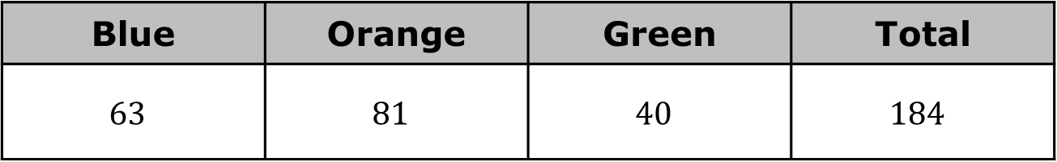
A conjecture is an important step in problem-solving. Conjectures arise when you notice a pattern and that pattern holds true for many cases. However, just because a pattern holds true for many cases does not mean that the pattern will hold true for all cases. Conjectures must be proven for the mathematical observation to be fully accepted. When a conjecture is rigorously proven, it becomes a theorem.
The values for step 10 are shown. Use these values to test your conjecture. Revise your conjecture if necessary.
Blue | Orange | Green | Total
$$63$$ | $$81$$ | $$40$$ | $$184$$
volume 1, pg. 90

Slide 12
Ask a classmate for their conjectures. Record their conjectures and write your summary of their reason. You are the only person who should write in the conjecture and summary columns of the table. Have the person initial next to your summary stating that your summary was correct.
Color | Conjecture | My Summary of Their Reason | Initials
Blue
Orange
Green
Total
volume 1, pg. 90

Slide 13
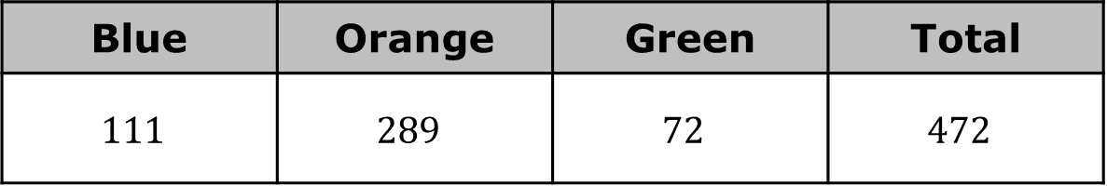
The conjectures from your classmate may be different from your conjectures, but that does not mean that one is wrong. Both may be correct.
Compare your conjecture with the conjectures you and your partner collected from different classmates.
The values for step 18 are shown. Use these values to test your classmates’ conjectures.
Blue | Orange | Green | Total
$$111$$ | $$289$$ | $$72$$ | $$472$$
volume 1, pg. 91

Slide 14

There are two types of reasoning that can be used to prove a conjecture.
Deductive reasoning uses facts and general principles to draw conclusions.
Deductive Reasoning
Definitions
Postulates
Properties
Theorems
Conclusion
volume 1, pg. 91

Slide 15

Inductive reasoning uses specific observations and patterns to draw conclusions.
Inductive Reasoning
Pattern
Conjecture
Verify/Modify
volume 1, pg. 91

Slide 16
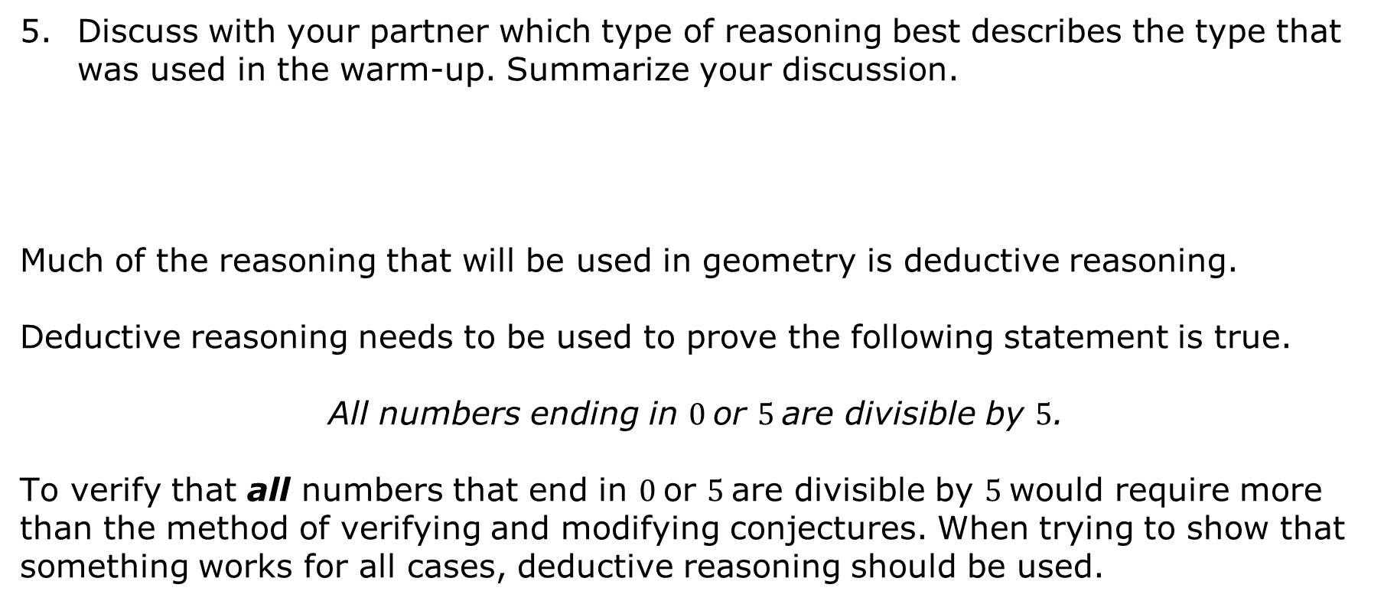
Discuss with your partner which type of reasoning best describes the type that was used in the warm-up. Summarize your discussion.
Much of the reasoning that will be used in geometry is deductive reasoning.
Deductive reasoning needs to be used to prove the following statement is true.
All numbers ending in $0$or $5$are divisible by $5$.
To verify that all numbers that end in $0$or $5$are divisible by $5$would require more than the method of verifying and modifying conjectures. When trying to show that something works for all cases, deductive reasoning should be used.
volume 1, pg. 92

Slide 17
The following statement is an example of inductive reasoning.
All small dogs in the park today have blue collars. Therefore, all small dogs have blue collars.
Discuss with your partner if it is possible that there existed a scenario that could have led to the conclusion. Write a short explanation.
Write a counterexample that would disprove “all small dogs have a blue collar.”
A counterexample is a statement that disproves a conjecture.
volume 1, pg. 92

Slide 18

Bring It Together
volume 1, pg. 93

Slide 19

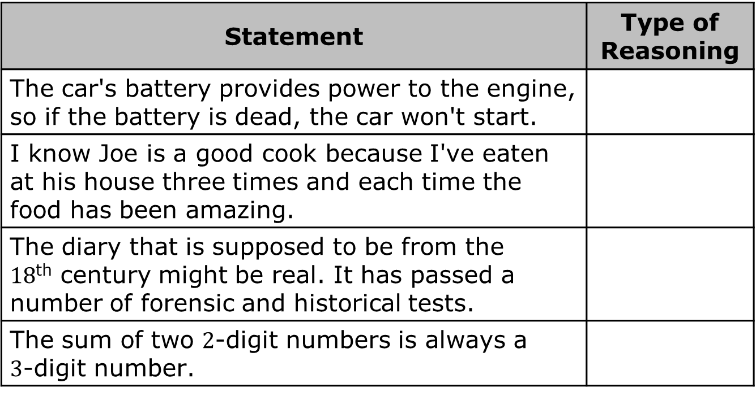
2.2.3 Bring It Together: Using Reasoning
Determine the type of reasoning for each statement.
Statement | Type of Reasoning
The car's battery provides power to the engine, so if the battery is dead, the car won't start.
I know Joe is a good cook because I've eaten at his house three times and each time the food has been amazing.
The diary that is supposed to be from the $18$^{th} century might be real. It has passed a number of forensic and historical tests.
The sum of two $2$-digit numbers is always a $3$-digit number.
volume 1, pg. 93

Slide 20
For each statement, write a counterexample that disproves the statement.
If a number is multiplied by itself, then the product is even.
Adding the same number to both the numerator and the denominator of a fraction does not change the fraction's value.
volume 1, pg. 93

Slide 21

Wrap-Up
volume 1, pg. 93

Slide 22
2.2.4 Wrap-Up: Cool Down
Write a statement that uses deductive reasoning.
2. Write a counterexample to the statement.
volume 1, pg. 93

